Slide 1
Semantic Analysis,
Symbol Tables and Scoping Rules

Slide 2
Cool Semantic Analysis ?
An identifier should be declared (in the same scope) at most once
An identifier should not be used if not declared.
Type of the left-hand side of an assignment should match the type of the right-hand side
Inheritance relations should not cause “loops”
Classes should be defined only once
Methods in a class should be defined only once
Number of arguments (in call) should match the number of formals (in declaration) and the corresponding types
…

Slide 3
Semantic Analysis
Checking for “correct meaning”
Warn about dubious meaning
Long-distance and deep relations
Lexer and parser are only short-distance
Implemented using AST traversals

Slide 4
Scope of an identifier
The part of the program in which the identifier is accessible or visible
An identifier may have restricted scope
Same identifier may refer to different things in different parts of the program
Different scopes for same name don’t overlap
Not all kinds of identifiers follow the most-closely nested rule (dynamic scoping as an example)

Slide 5
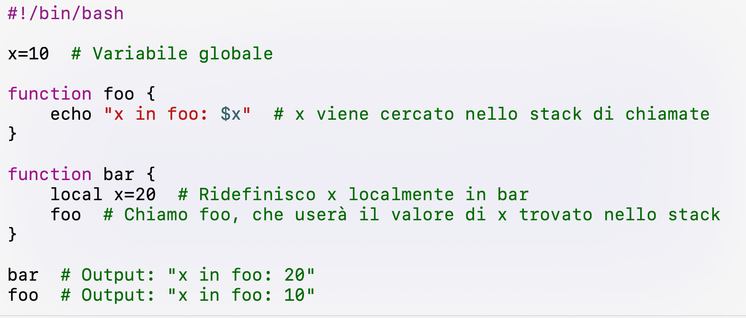
Simple example of dynamic scoping
Bash shell follows dynamic scoping

Slide 6
Scopes
class Foo {
value : Int ← 39;
test() : Int {
let b:Int ←3 in
value + b
};
setValue(c:Int):Int {{
value ← c;
let d:Int ← c in {
c ← c + d;
value ← c;
};
}};
};
public class Bar {
value:Int ← 42;
setValue(int c):Int {
value ← c;
}
}
scope of b
scope of value
scope of c
scope of d
scope of value
scope of c

Slide 7
Where do identifiers come from ?
(How do we introduce identifier bindings in Cool ?)
Let expressions
Formal parameters
Attribute definitions
Case expressions
Class declarations (class names)
Method declarations (method names)
(object ids)

Slide 8
Scope rules
Match identifier declarations with uses
Why ?
for type checking…
Let y : String ← “abc” in y + 3
declaration use
Static scope - depends only on the program text, not runtime behavior

Slide 9
Scope of Let
“most-closely nested” rule
let x : Int ← 0 in {
x;
let x : Int ← 2 in
x;
x;
}

Slide 10
Scope of Class Definitions
Cannot be nested (non vi sono classi annidate e se vi sono le classi inerne non vedono dichiarazioi delle classi esterne)
Globally visible
Class name can be used before it is defined
Class Foo {
… let y : Bar in …
}
Class Bar {
…
}

Slide 11
Scope of Attributes
Global within the class in which they are defined
Can be used before defined in the class
Class Foo {
f() : Int { a };
a : Int ← 0;
}

Slide 12
Scope of Methods
Method need not be defined in the class in which it is used, but in some parent class
Overriding - methods may be redefined
class A {
foo():Int { …};
};
class B inherits A { };
class C { b : B ← new B;
bar():Int{ b.foo() };
};

Slide 13
Scope of Methods
Overriding - methods may be redefined
class A {
foo():Int { …};
};
class B inherits A {
foo():Int {…};
};
class C { b : B ← new B;
bar():Int{ b.foo() };
};

Slide 14
Some Cool Scope Rules
local variable declared before use
attributes need not be declared before use
variables cannot be defined multiple times in same scope, but can be redefined in nested scopes
class A {
x : String ← “a”;
foo(x : Int, x : String): SELF_TYPE{ x };
};
it is allowed to shadow method parameters

Slide 15
What is Symbol Table ?
Scopes implemented using symbol tables
Data-structure for “look-up”
key – identifier
value – type of identifier, other semantic properties

Slide 16
Symbol Table - 1st Attempt
class Test {
a: Int ← 39;
test(): Int {
let b:Int ← 3 in
a + b
};
};
Symbol | Kind | Type | Properties
a | var | Int | …
b | var | Int | …
test | method | -> Int | …

Slide 17
Symbol Table - 1st Attempt
class Test {
a: Int ← 39;
test(): Int {
let a: String ← “hello”,
b:Int ← 3 in
b
};
};
Symbol | Kind | Type | Properties
a | var | Int | …
b | var | Int | …
test | method | -> Int | …
a | var | String | …

Slide 18
Implementing Scopes
Let x : Int ← 0 in e
before processing e
add definition of x to current definitions (defined just before entering this let instruction)
override any other previous definition of x
after processing e
remove definition of x
restore old definition of x

Slide 19
Symbol Table – 2nd Attempt
class Foo {
value : Int ← 39;
test(b:Int) : Int {
value + b
};
setValue(c:Int):Int {{
value ← c;
let d:Int ← c in {
c ← c + d;
value ← c;
};
}};
};

Slide 20
Symbol Table – 2nd Attempt
…
(Foo)
Symbol | Kind | Type | Properties
value | var | Int | …
test | method | -> Int
setValue | method | Int -> Int
(test)
(setValue)
Symbol | Kind | Type | Properties
b | var | Int | …
Symbol | Kind | Type | Properties
c | var | Int | …
(setValue-block)
Symbol | Kind | Type | Properties
d | var | Int | …

Slide 21
Symbol Table Lookup
(Foo)
Symbol | Kind | Type | Properties
value | var | int | …
test | method | -> int
setValue | method | int -> int
(Test)
(setValue)
Symbol | Kind | Type | Properties
b | var | int | …
Symbol | Kind | Type | Properties
c | var | int | …
(setValue-block)
Lookup(value)
setValue(c:Int):Int {{
value ← c;
let d :Int ← c in {
c ← c + d;
value ← c;
};
}};
Symbol | Kind | Type | Properties
d | var | int | …

Slide 22
Symbol Table Lookup
Error !
(Foo)
Symbol | Kind | Type | Properties
value | var | int | …
test | method | -> int
setValue | method | int -> int
(Test)
(setValue)
Symbol | Kind | Type | Properties
b | var | int | …
Symbol | Kind | Type | Properties
c | var | int | …
(setValue-block)
Lookup(myValue)
Symbol | Kind | Type | Properties
d | var | int | …
setValue(c:Int):Int {{
value ← c;
let d :Int ← c in {
c ← c + d;
myValue ← c;
};
}};

Slide 23
Symbol Table Construction
class Foo {
value : Int ← 39;
test(b:Int) : Int {
value + b;
};
setValue(c:Int):Int {{
value ← c;
let d:Int ← c in {
c ← c + d;
value ← c;
};
}};
};
root
Class
name=Foo
Method
Method
name=test
name=setValue
Expr
Let
id=d
Expr
Expr
Expr
Expr
(some details omitted)

Slide 24
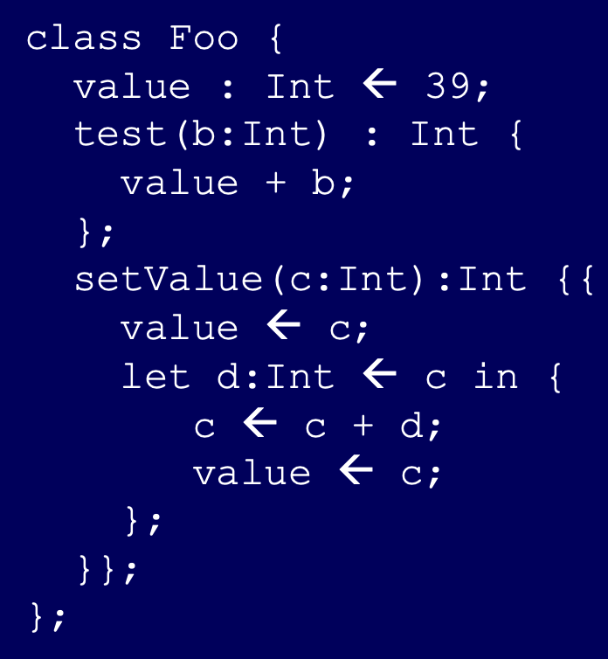
Symbol Table Construction via AST Traversal
globals
root
Symbol | kind
Foo
class
Class
Foo
name=Foo
Symbol | kind
test
method
setValue
method
Method
Method
name=test
name=setValue
test
setValue
Symbol
Symbol
b
var
c
var
Let
Expr
Let
Symbol
id=d
d
var
Expr
Expr
Expr
Expr
(some details omitted)

Slide 25
Symbol Table Construction via AST Traversal
globals
root
Symbol | kind
Foo
class
Class
Foo
name=Foo
Symbol | kind
test
method
setValue
method
Method
Method
name=test
name=setValue
test
setValue
Symbol
Symbol
b
var
c
var
Let
Expr
Let
Symbol
id=d
d
var
Expr
Expr
Expr
Expr
(some details omitted)

Slide 26
Implementation
SymbolTable.java
symbol table - stack of scopes
scope – hash table <key, value>
key is AbstractSymbol
value is Object
generic – do we need store and lookup in other cases ?
SymtabExample.java

Slide 27
Implementation
enterScope() | start a new nested scope
lookup(x) | finds current x (or null)
addId(x) | adds a symbol x to the table
probe(x) | true if x defined in current scope
exitScope() | exit current scope

Slide 28
Implementation
Symbol table key should combine id and kind
separating table in advance according to kinds
method, attribute/local variable bindings, classes
implement using 2-level maps (kind->id->value)
implement this using key objects ( (kind,id)->value) )

Slide 29
Symbol Tables (cont’d)
globals
Symbol | kind
class A {
foo() {
bar();
}
bar() {
…
}
}
root
A
class
Program
A
Symbol | kind
foo
method
bar
method
Class
id=A
Method
Method
id=foo
id=bar
Undefined identifier bar()
dispatch
id=bar()

Slide 30
Passes
Semantic analysis requires multiple passes
probably more than 2
pass 1: build symbol table
pass 2: do the checking

Slide 31
Symbol Tables (cont’d)
globals
Symbol | kind
class A {
foo() {
bar();
}
bar() {
…
}
}
root
A
class
Program
A
Symbol | kind |  | FREF
foo
method
bar
method
true
Class
id=A
Method
Method
id=foo
id=bar
Dispatch
id=bar()
31

